Slide 1
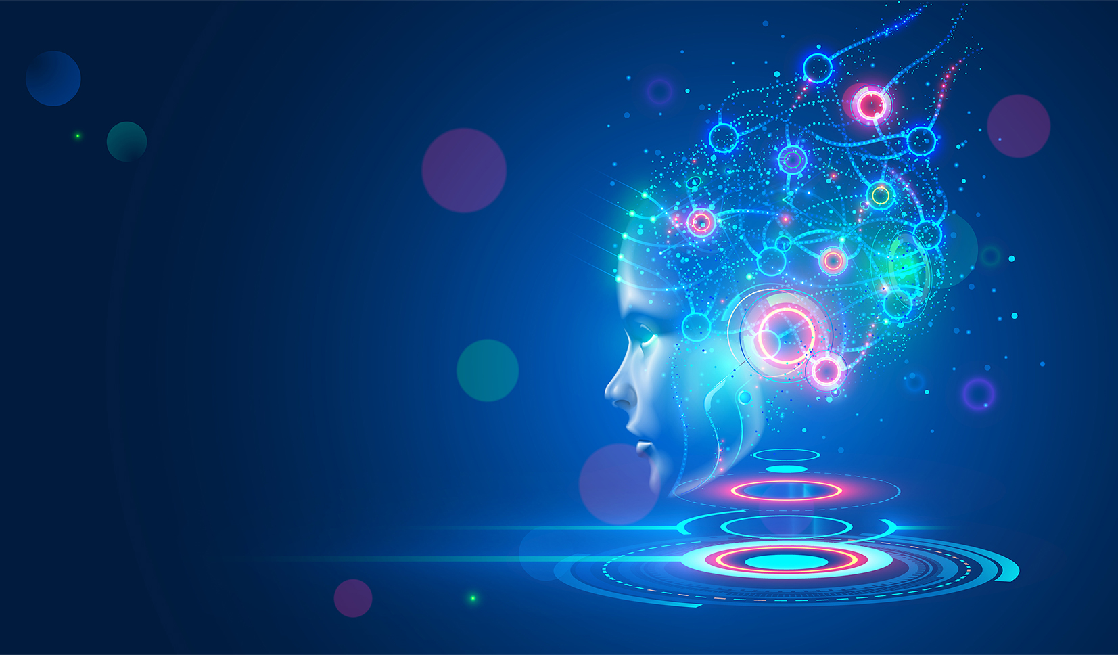
INT 404: Artificial Intelligence
Topic: AI IN SMART HOME
Submitted By:
Name: Arnab Sarkar Armaan Kumar Vikash Pandey
Reg No.: 12105922 12111817 12106224
Roll No.: RK21ANA19 RK21ANB43 RK21ANB67
Submitted To: Mrs. Ankita Wadhawan

Slide 2
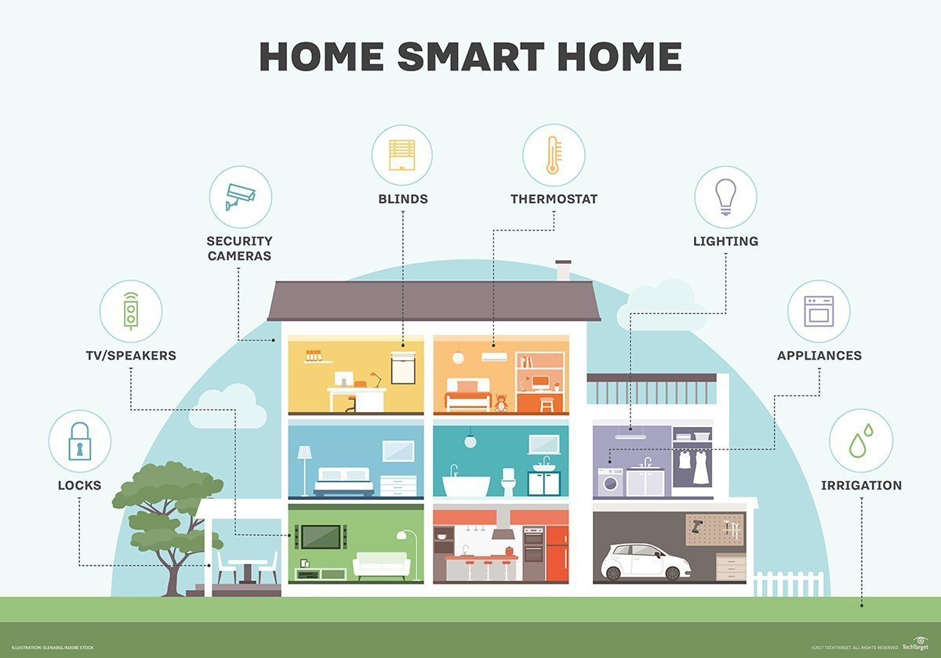

Slide 3

Introduction
Artificial Intelligence (AI) is transforming the way we live in our homes by making them smarter, more convenient, and energy-efficient. AI-powered smart home systems are equipped with connected devices and sensors that allow them to learn and respond to user behavior and preferences. These systems can automate and control various household functions, such as lighting, temperature, security, and entertainment, using voice assistants and intuitive interfaces. With predictive maintenance, AI can detect potential issues before they become major problems, and with personalized recommendations, it can help users save energy and reduce their carbon footprint. As the technology advances, AI is expected to revolutionize the way we interact with our homes and improve our quality of life.

Slide 4
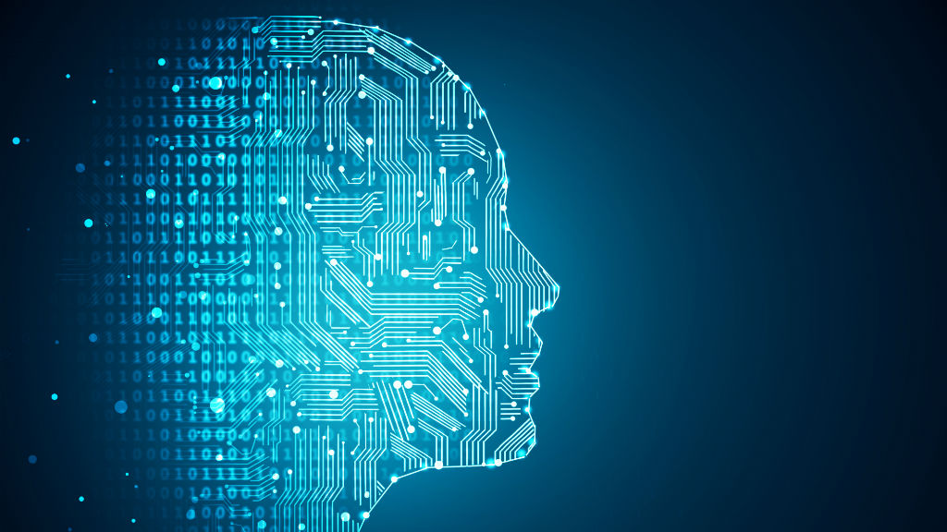

How AI Works in Smart Homes
AI works in smart homes by using machine learning algorithms to analyze and process data from connected devices and sensors. These algorithms can identify patterns and make predictions about user behavior, preferences, and needs, and then use this information to automate and optimize various household functions. These algorithms are trained on large amounts of data and can continuously improve over time, becoming more accurate and efficient at predicting user behavior.
For example, a smart thermostat that uses AI can learn from a user's behavior to anticipate when they will be home and adjust the temperature accordingly. A security system with AI can detect unusual activity and notify the homeowner, while a smart lighting system can adjust brightness and color temperature based on time of day or user preference.

Slide 5
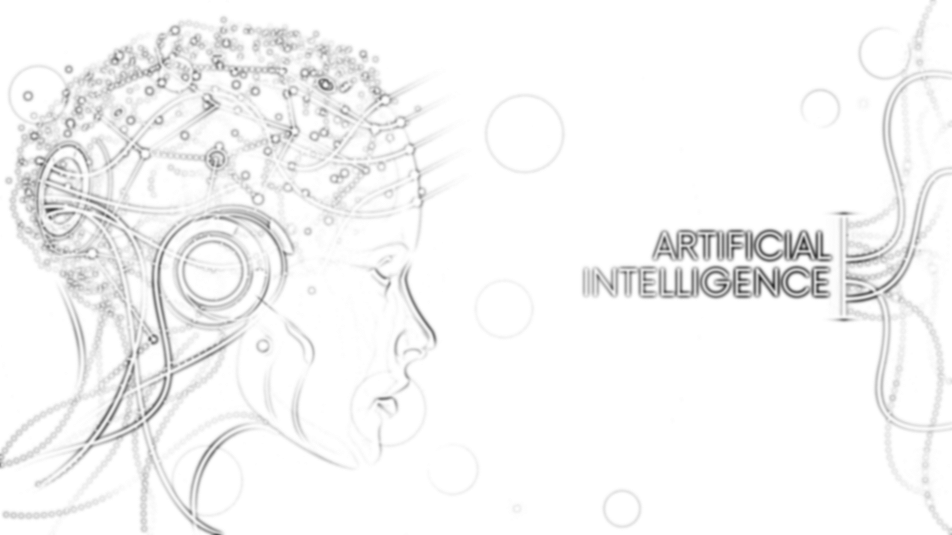
Voice assistants such as Amazon's Alexa and Google Home also use AI to understand and respond to user commands. They can learn from user behavior and preferences, providing personalized recommendations and reminders. These assistants can also integrate with other smart devices in the home, allowing users to control various functions through voice commands.
Overall, AI allows smart homes to become more intuitive, convenient, and energy-efficient. By automating routine tasks and optimizing energy usage, AI can save homeowners time, money, and effort while improving their quality of life.

Slide 6
Ex: Alexa Working Model
The working model of Alexa can be divided into four main components: wake word detection, automatic speech recognition, natural language understanding, and action fulfillment. Here is a brief overview of each component:
1.) Wake Word Detection: The first component of Alexa's working model is wake word detection. When a user says "Alexa," the device wakes up and starts listening for voice commands. The wake word detection technology uses machine learning algorithms to identify the wake word in the audio stream, even in noisy environments.
2.) Automatic Speech Recognition: The second component of Alexa's working model is automatic speech recognition (ASR). Once the device detects the wake word, it captures the audio and sends it to Amazon's cloud-based ASR service. The ASR service uses neural networks to convert the audio into text.

Slide 7

3.) Natural Language Understanding: The third component of Alexa's working model is natural language understanding (NLU). Once the ASR service converts the audio into text, it sends the text to another cloud-based service called the NLU service. The NLU service uses machine learning algorithms to understand the user's intent and extract relevant information from the text.
4.) Action Fulfillment: The final component of Alexa's working model is action fulfillment. Once the NLU service understands the user's intent and extracts relevant information, it sends a request to the appropriate service or skill to perform the desired action. For example, if a user asks Alexa to play a song, the NLU service sends a request to the music streaming service to play the requested song.
The working model of Alexa is a complex system that depends on advanced machine learning algorithms and cloud-based services to offer a smooth and effortless user experience.

Slide 8
Applications of AI in Smart Homes
  AI has many applications in smart homes, including:
  1.) Energy Management: AI can be used to optimize energy usage in smart homes. Smart thermostats can use machine learning algorithms to learn user preferences and adjust the temperature accordingly, resulting in energy savings. Smart lighting systems can also use AI to adjust brightness and color temperature based on time of day, user behavior, and preferences.
  2.) Home Security: AI can be used for security and surveillance in smart homes. Smart cameras and sensors can use machine learning algorithms to detect unusual activity and send alerts to the homeowner's phone. Facial recognition technology can also be used to identify authorized individuals and prevent unauthorized access.

Slide 9
3.) Voice Assistants: Voice assistants such as Amazon's Alexa and Google Home use AI to understand and respond to user commands. They can learn from user behavior and preferences, providing personalized recommendations and reminders. These assistants can also integrate with other smart devices in the home, allowing users to control various functions through voice commands.
4.) Predictive Maintenance: AI can be used for predictive maintenance, where smart devices can detect potential issues before they become major problems. For example, a smart water leak detector can use AI to detect leaks and send an alert to the homeowner's phone.
5.) Health and Wellness: AI can be used to monitor and improve the health and wellness of occupants in smart homes. Smart devices can track activity levels, sleep patterns, and even detect potential health issues such as falls or abnormal vital signs.

Slide 10
  6.) Home Entertainment: AI can be used to enhance home entertainment experiences, by providing personalized recommendations for movies, TV shows, and music based on user preferences.
  Overall, AI has many applications in smart homes, providing benefits such as increased convenience, energy savings, improved security and safety, and enhanced entertainment experiences. As the technology continues to advance, more innovative applications of AI in smart homes are likely to emerge, creating even more opportunities for homeowners to live smarter and more sustainable lives.

Slide 11
PROS and CONS Of AI in Smart Homes
PROS:-
Artificial Intelligence (AI) can bring many benefits to smart homes, including:
1.) Increased convenience: AI can automate various tasks and processes within a smart home, such as turning on lights, adjusting the temperature, and even ordering groceries. This can save time and make life more convenient for homeowners.
2.) Improved energy efficiency: AI-powered smart homes can optimize energy usage by adjusting temperature settings and turning off appliances when they are not in use. This can lead to lower energy bills and a reduced carbon footprint.
3.) Enhanced security: AI-powered security systems can detect unusual activity and alert homeowners or authorities if there is a potential threat. AI can also analyze data from security cameras to identify potential intruders and improve overall security.

Slide 12
4.) Personalization: AI can learn the preferences of homeowners and personalize the smart home experience accordingly. For example, an AI-powered smart home can adjust lighting and temperature settings based on a homeowner's daily routine.
5.) Remote access: AI-powered smart homes can be controlled remotely, giving homeowners access to their home's systems and appliances from anywhere. This can be particularly useful for people who travel frequently or have multiple homes.
Overall, AI can bring a lot of benefits to smart homes, making them more convenient, efficient, secure, and personalized.

Slide 13
CONS:
While AI can bring many benefits to smart homes, there are also potential drawbacks to consider, such as:
1.) Privacy concerns: AI-powered smart homes collect a lot of data on the behavior and habits of the occupants. This data can be sensitive and may be misused if it falls into the wrong hands. Additionally, some people may feel uncomfortable with the idea of being constantly monitored by technology.
2.) Dependence on technology: Smart homes rely on technology to function, and AI is no exception. If the AI system malfunctions or there is a power outage, homeowners may not be able to control their home's systems and appliances.

Slide 14
3.) Complexity: AI-powered smart homes can be complex to set up and maintain. Homeowners may need to have some technical knowledge to troubleshoot issues or make changes to their system.
4.) Cost: AI-powered smart homes can be expensive to set up and maintain, as they often require specialized equipment and ongoing technical support.
5.) Potential for errors: AI-powered smart homes are only as good as the algorithms they use. If the algorithms are not accurate or reliable, the AI system may make errors or fail to function properly.
Overall, while AI can bring many benefits to smart homes, it is important to be aware of the potential drawbacks and take steps to mitigate them.

Slide 15
Conclusion
I has revolutionized the concept of smart homes by providing homeowners with a range of innovative and intelligent solutions that make their lives easier and more convenient. From voice assistants like Alexa and Google Assistant to smart thermostats, security systems, and appliances, AI-powered technology is transforming the way we interact with our homes. With the ability to learn from our behaviors and adapt to our preferences, AI is making smart homes more personalized and responsive than ever before. As AI continues to evolve and improve, we can expect even more exciting and transformative developments in the field of smart homes in the years to come, ushering in a new era of home automation and convenience.

Slide 16
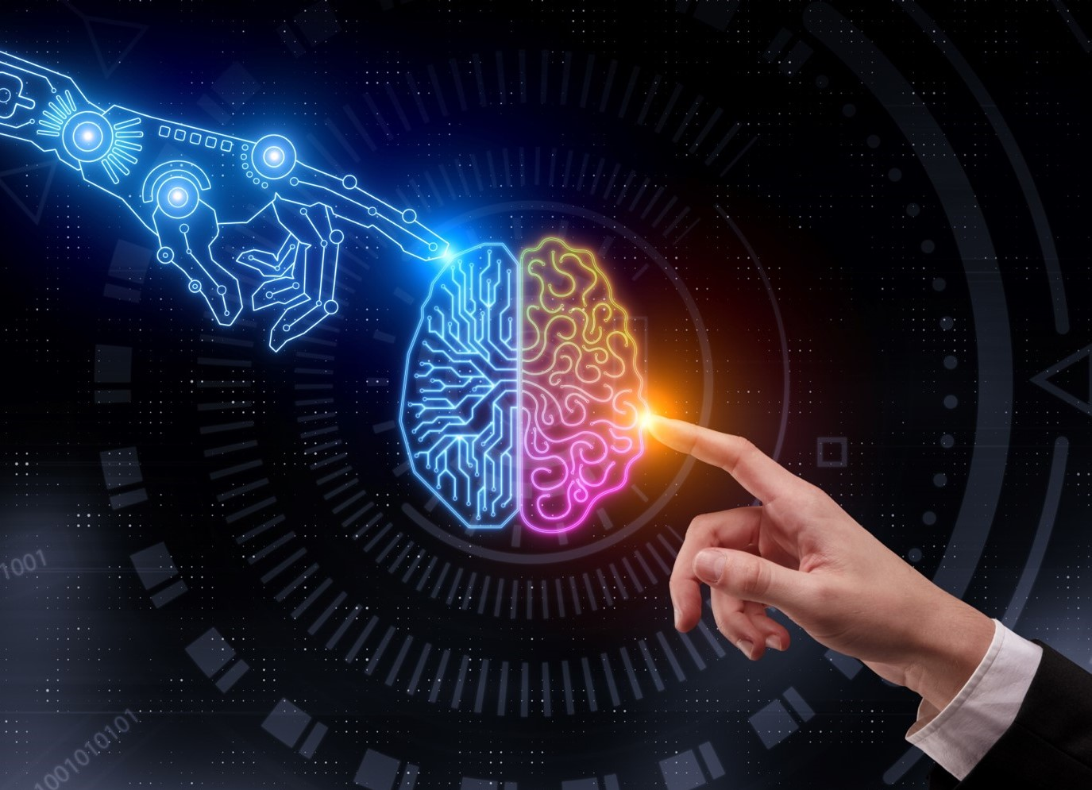
Thank You

